Slide 1


Web Scraping and
Facebook AB Testing
David J. Hardisty
UBC Sauder School of Business
SCP Doctoral Consortium 2021
March 4, 2021
Notes:
Disclaimer:
I’ve used these tools
I’ve worked as a web developer
I have a few tips
I’m no expert!

Slide 2
Outline
Why?
Intro to web scraping
  Example
  How-to
  Tips & problems
Intro to Facebook AB Testing
  Example
  How-to
  Tips & problems
Resources

Slide 3
Why Scraping & Facebook AB Testing?
Most consumer behaviour is online
Supreme external validity
“Relevance test” of your theory
You often need field studies to publish

Slide 4

Web scraping: Example
Kiva.org
*Preliminary* finding:
Including both current funding and order, there is a negative relationship between current funding and donations
Rishad Habib
PhD Superstar
Pr(>|t|) Estimate t-test
Funding -0.0046052 0.0004150 -11.10 <2e-16 ***
Order -0.0050541 0.0002671 -18.92 <2e-16 ***
---
Signif. codes: ‘***’ = 0.001

Slide 5

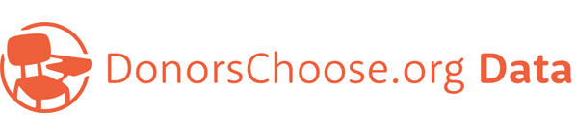
Web Scraping: How To (3 tips)
1) Don’t!
There are many readily downloadable datasets that can be
used in lieu of scraping your own novel dataset.
Other sources:
Kaggle; Webrobots.io, Recommender Systems Database, IMDb
6,685,900 reviews, 192,609 businesses,
200,000 pictures, 10 metropolitan areas
901,965 projects, 402,900 teachers,
4,687,844 donations, 2,024,554 donors

Slide 6
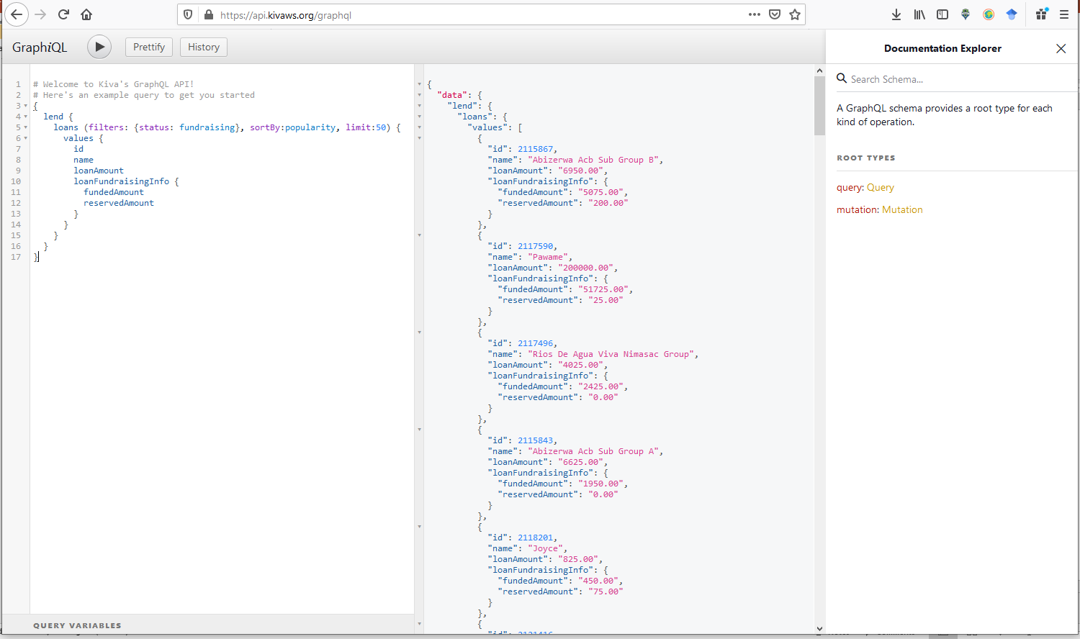
Web Scraping: How To
2) Don’t!
Many websites including Twitter, Facebook, NYT, Kiva, offer APIs
API gives you the data in a structured format
API gives you data with consent
Example: https://api.kivaws.org/graphql
You’ll need to do some coding
(packages such as rtweet exist)
Or hire someone!
  https://www.fiverr.com
  https://www.upwork.com/

Slide 7
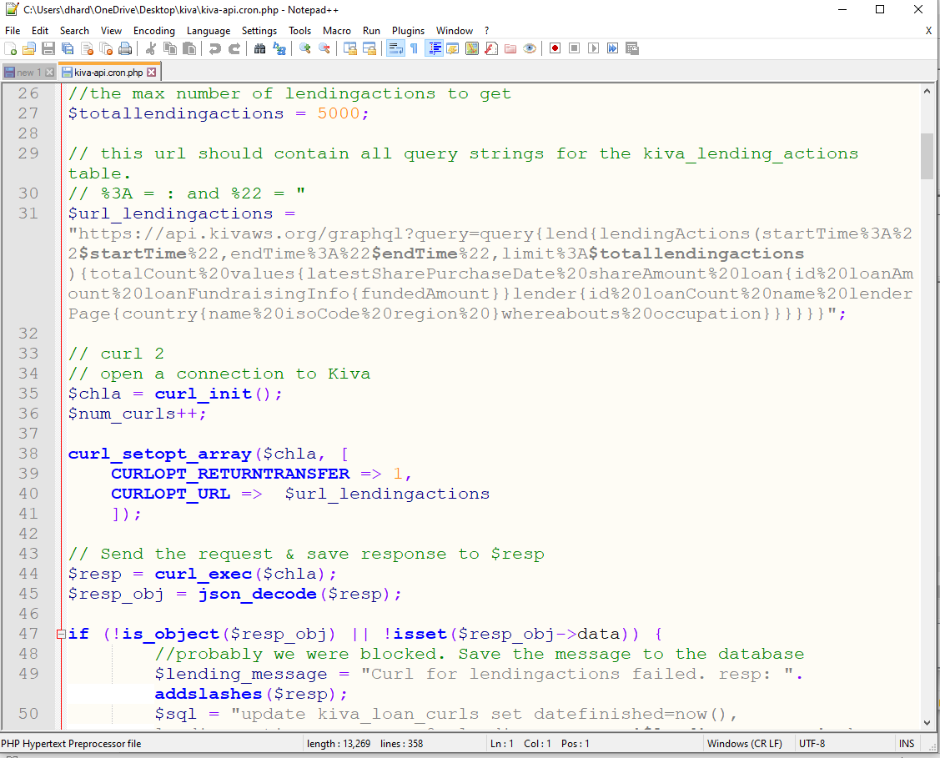
Web Scraping: How To
3) Code it
Every website is different – requires custom work
rvest is a useful package to harvest data
I used PHP & MySQL
Hire someone!
May be legal issues (e.g., copyright)
May face anti DoS protection

Slide 8
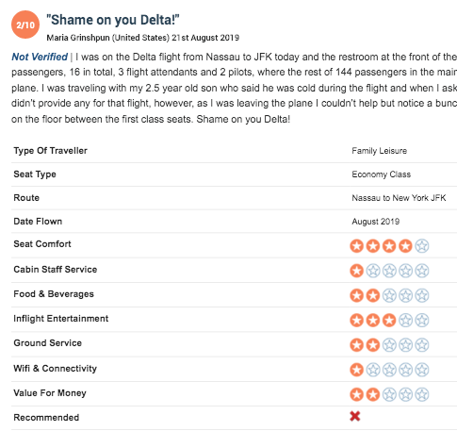
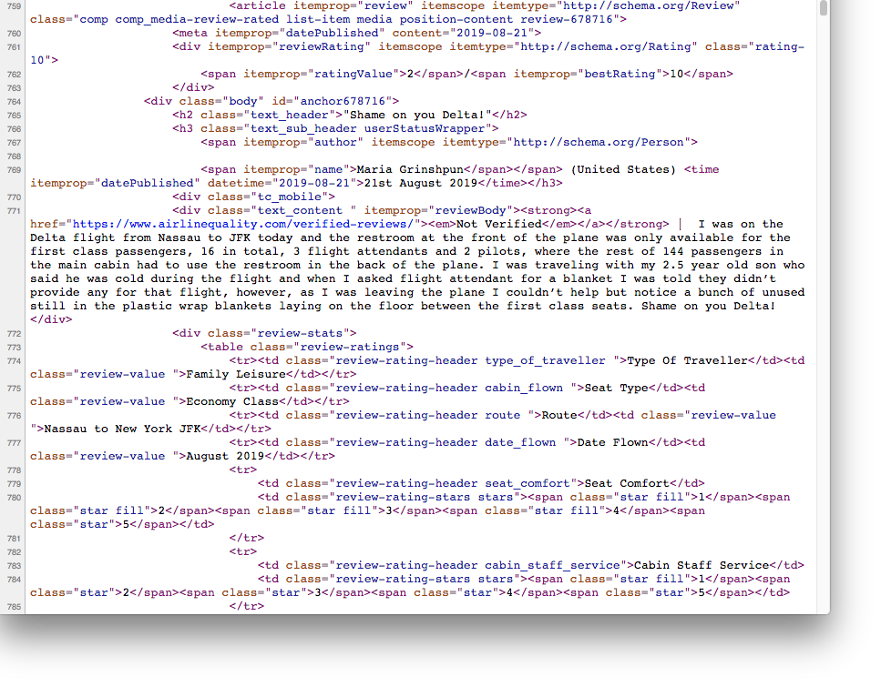
Web Scraping: How To
3) Code it

Slide 9
Web scraping: tips & problems
Make friends with our quant friends
P-hacking is a real issue -> pre-register

Slide 10
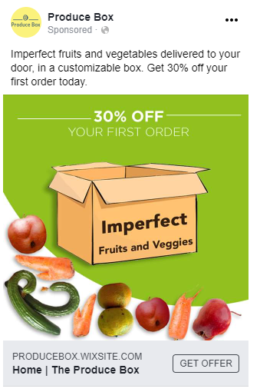
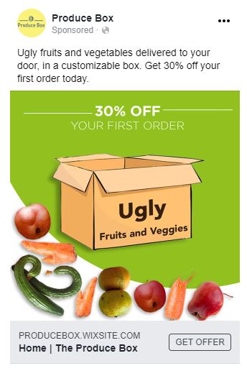
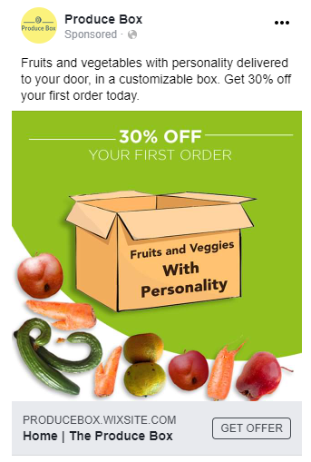
Facebook AB Testing: Examples
Objective : comparing labels that vary in the extent to which they directly point to the aesthetic flaw (“ugly”, “with personality”, “imperfect”, control).
Study 6a: Hypothetical purchase of unattractive produce
Study 6b: Actual clicks on Facebook ads
Pre-registered prediction: “Ugly” Labeling is most effective.
Mookerjee, S., Cornil, Y., & Hoegg, J. (2021). From Waste to Taste: How “Ugly” Labels Can Increase Purchase of Unattractive Produce. Journal of Marketing, Forthcoming.

Slide 11

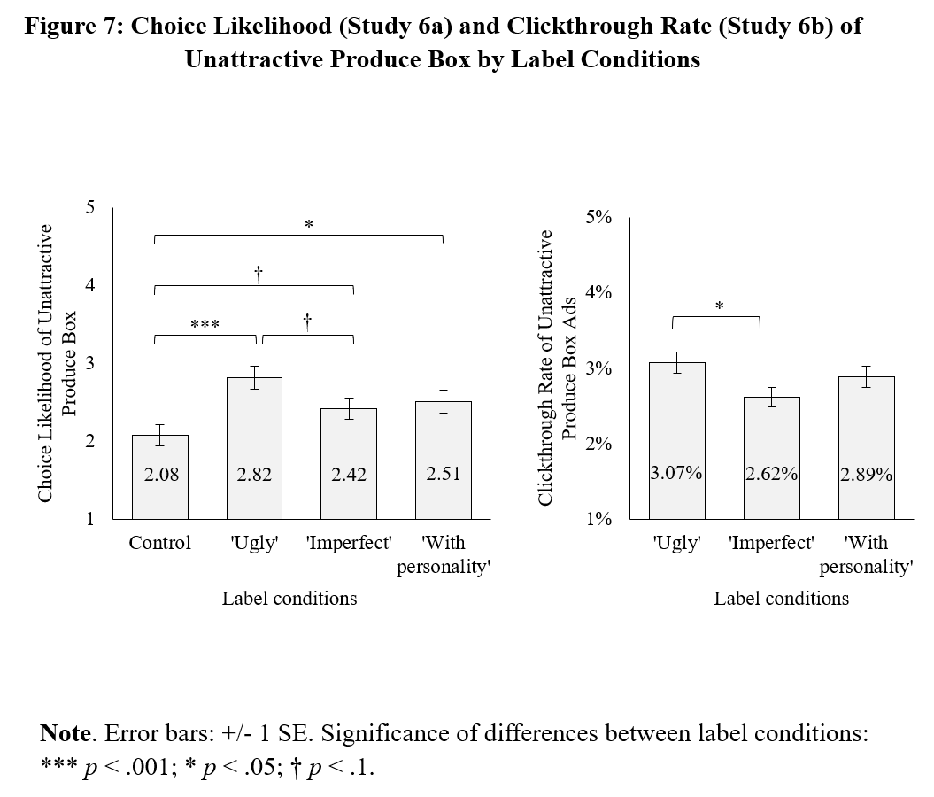
Facebook AB Testing: Examples
Sid Mookerjee
PhD Superstar

Slide 12
Facebook AB Testing: How To
Facebook ad manager is usable with no coding skills
Split test on creative
Be sure ads have the same “ad score”
Target clicks
Run on all platforms
Deduce your datafile from the FB summary data
Analyze with logistic regression or Poisson

Slide 13
Facebook AB Testing: Tips & problems
Limits on ad design -> do an early test of one condition
Constantly changing “black box”
Optimization is a serious threat to internal validity
  You are not testing A vs B, you are testing A+optimization vs B+optimization
Users can “like”, share, and comment on ads (depending on settings)
Not as cheap as MTurk

Slide 14
Resources (**=highly recommended)
**Web scraping for marketing research:
https://www.msi.org/working-papers/fields-of-gold-web-scraping-for-consumer-research/
Boegershausen, Johannes; Borah, Abhishek; Datta, Hannes; Stephen, Andrew T. (2021), “Fields of Gold: Web Scraping for Marketing Research”.
**Field experiments on Facebook:
https://www.sciencedirect.com/science/article/abs/pii/S014829632030429X?via%3Dihub
Orazi, D. C., & Johnston, A. C. (2020). Running field experiments using Facebook split test. Journal of Business Research, 118, 189-198.
JCP paper using Facebook field experiments, with some methodological notes:
Hardisty, D. J., & Weber, E. U. (2020). Impatience and Savoring vs. Dread: Asymmetries in Anticipation Explain Consumer Time Preferences for Positive vs. Negative Events. Journal of Consumer Psychology, 30(4), 598-613.
https://doi.org/10.1002/jcpy.1169
JM paper using Facebook field experiments:
Mookerjee, S., Cornil, Y., & Hoegg, J. (2021). From Waste to Taste: How “Ugly” Labels Can Increase Purchase of Unattractive Produce. Journal of Marketing, Forthcoming.
Facebook resources for executing an ad campaign: https://educator.facebookblueprint.com/student/path/205562-execute-an-ad-campaign

Slide 15
Thank you!

